Slide 1
CHAPTER 2: Classes and Objects

Slide 2
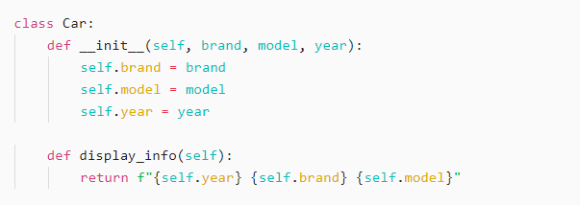
OOP Concepts - Class
Object-Oriented Programming (OOP) is a paradigm that helps structure programs into reusable and modular code. The fundamental building blocks of OOP are classes and objects.
A class is a blueprint for creating objects. It defines attributes (data) and methods (functions) that describe the behavior of the objects.
Syntax

Slide 3
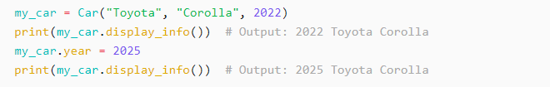
OOP Concepts - Object
An object is an instance of a class. It holds real data and interacts with other objects.
Creating an object from a class

Slide 4
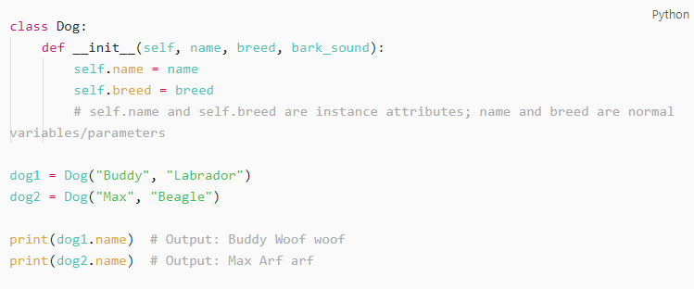
Instance attributes
Instance attributes are unique to each object. They are defined inside the `__init__()` method.

Slide 5
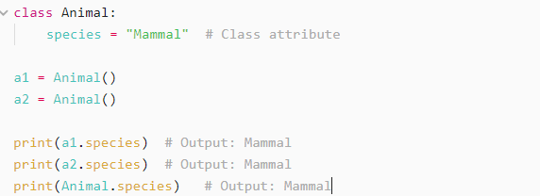
Class attributes
Class attributes are shared across all instances of a class.

Slide 6
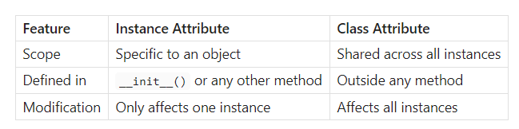
Class vs instance attributes

Slide 7
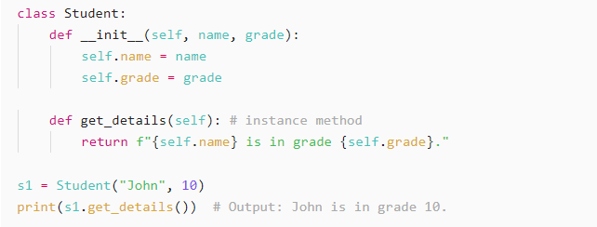
Instance Methods
A method, simply put, is a function in a class.
Instance methods are methods that have access to instance. Instance methods must take self as the first parameter.

Slide 8
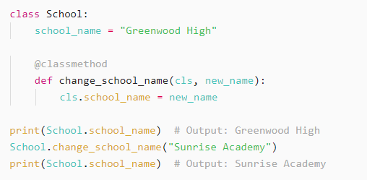
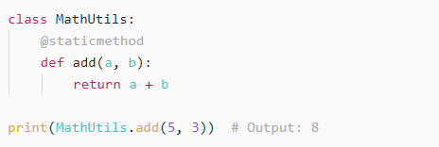
Class Methods
Class methods work on the class rather than an instance (they can still be accessed from the instances though).
Class methods cannot access the instance attributes or methods, only class attributes/methods
There are also static methods that are independent of class and instance attributes

Slide 9
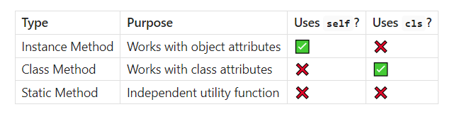
Class Methods

Slide 10
Working with objects in Django (practical session)
Django models and ORM

Slide 11
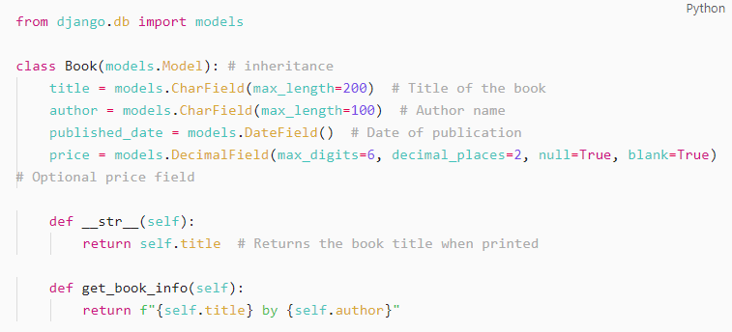
Defining a model
To define a model, create a class that inherits from models.Model and specify fields as class attributes.

Slide 12

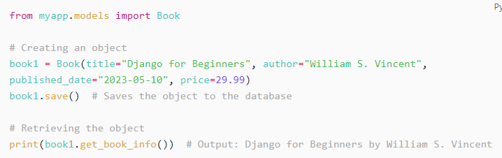
Creating an object in Django shell
Once a model is created (or modified), you need to create and apply migrations to update the database’s structure. Run the following commands:
We can use the Django shell to work with models. Run the command python manage.py shell.

Slide 13
Manipulating model objects
You can modify a record by modifying the object’s attributes and calling the save method.
Change book1’s title to “Advanced OOP in Python”, call the save method
Add 2 more books, book2 and book3 (don’t worry too much about being accurate)
Get all the books in the DB by calling Book.objects.all()
Delete book3 by calling its delete method
Get all the books in the DB again

Slide 14


